Slide 1

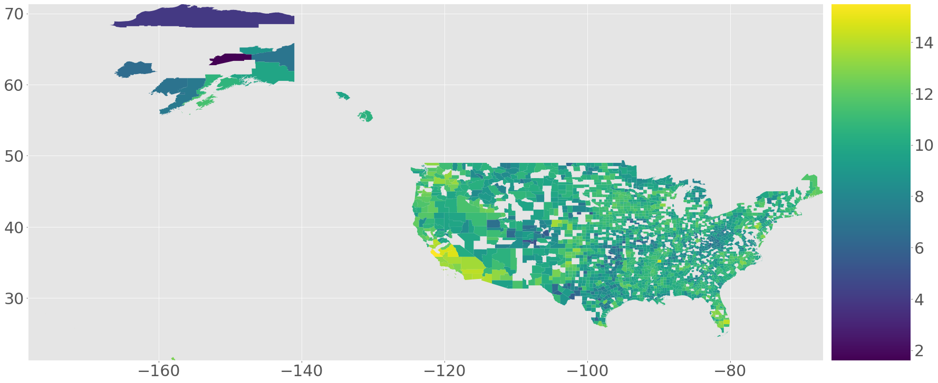
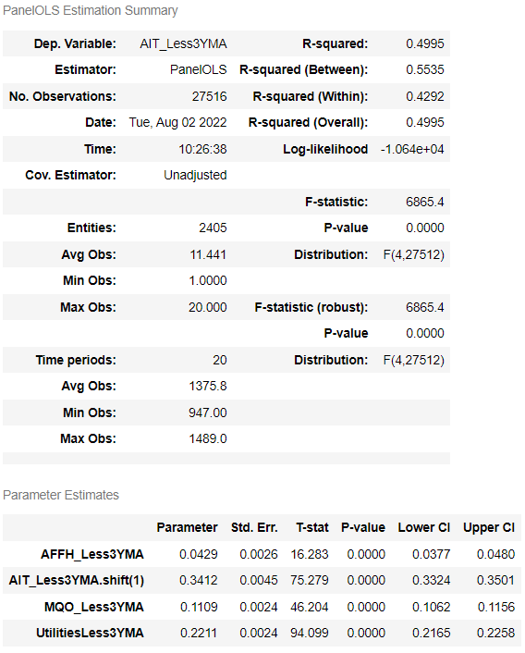
Nominal County GDP’s Influence on Surrounding Counties
Priyanka Davis | priyanka.shrestha@ndus.edu | Dickinson State University
Nicholas Walters | nicholas_walters3@outlook.com | Eastern Kentucky University
www.aisustein.com
Overview
Results
Nominal GDP is an indicator of the economic production resulting from inputs and outputs of the production process. The aim of this study was to use Austrian Capital Theory to show the influence that consumption and energy inputs have on county level GDP. A fixed effects regression model was used to measure the volatility of the GDP and GeoPandas was used to map the impact that inputs had on other surrounding counties…
Background and Aim
Conclusions
Talk about Austrian Capital Theory and the idea behind John Hick’s ACT framework
Explain the application on the GDP data set we are working with
- How can conclusions based on this lead to important results?
Methodology
References
- Imported BEA county GDP data for the years 2001 to 2020
Isolated variables that focused on inputs related to energy and consumption
  Utilities
  Agriculture
  Mining
Created a Data Frame with a 3-year moving average of the variables in the data set, which allowed us to remove short-term influences within such inputs
We logged and differenced variables with a 1-year time shift, which allowed us to measure the percentage of the volatility of the data.
Generated maps with GeoPandas which indicated the measure of volatility among each county and its surrounding influences
- Employed a Two-Way fixed effects model that took into account each of the variables mentioned above as well as a 1-year lag that measured the influence of past GDP values.
Heiss, F., & Brunner, D. T. (2020). Using python for introductory econometrics (1st ed.). Florian Heiss, Daniel Brunner.
Lewin, P., & Cachanosky Nicolás. (2019). Austrian Capital theory: A modern survey of the Essentials. Cambridge University Press.
Wooldridge, J. M. (2020). Introductory econometrics: A modern approach (7th ed.). Cengage.

